Slide 1
TENA SDS PARTS INSTALLATION REPORT
14-02-2019

Slide 2
Remaining items
Status Update
All SDS parts installed
Power tests carried out
Dispense functionality test carried out
Time taken: appx 7.5 hrs.
Tank probe installation & calibration
Modem cable extension
Calibration
Swapping flowmeter cable with the new one arriving soon

Slide 3
TESTING OPERATIONS
Testing Operations video link

Slide 4
QC Report
The following are the QC checklists provided by QC team on the field during the installation of the SDS parts - QC Report

Slide 5
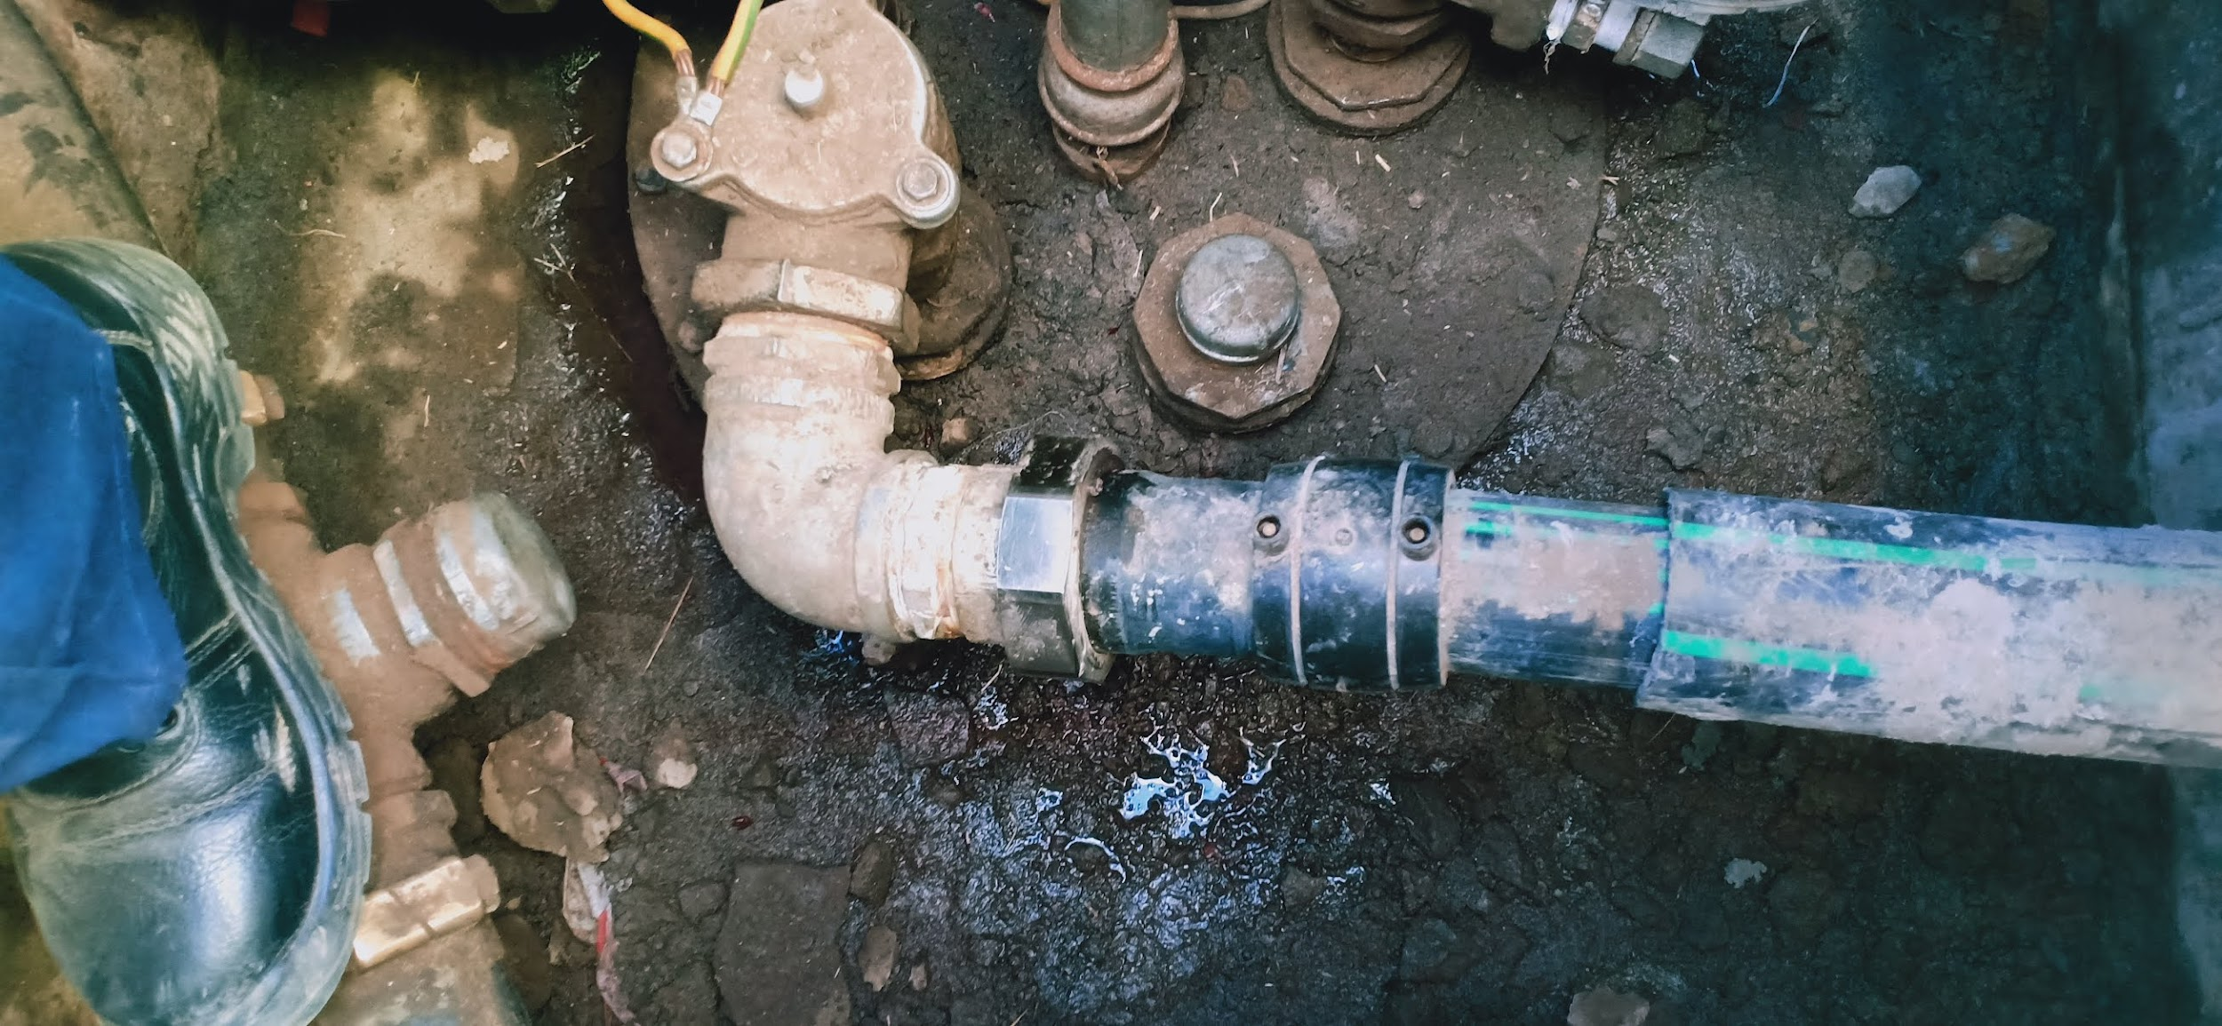
CHALLENGES
Leakage on union from underground tank to pump, no pressure test by contractor - Solved by tightening union

Slide 6
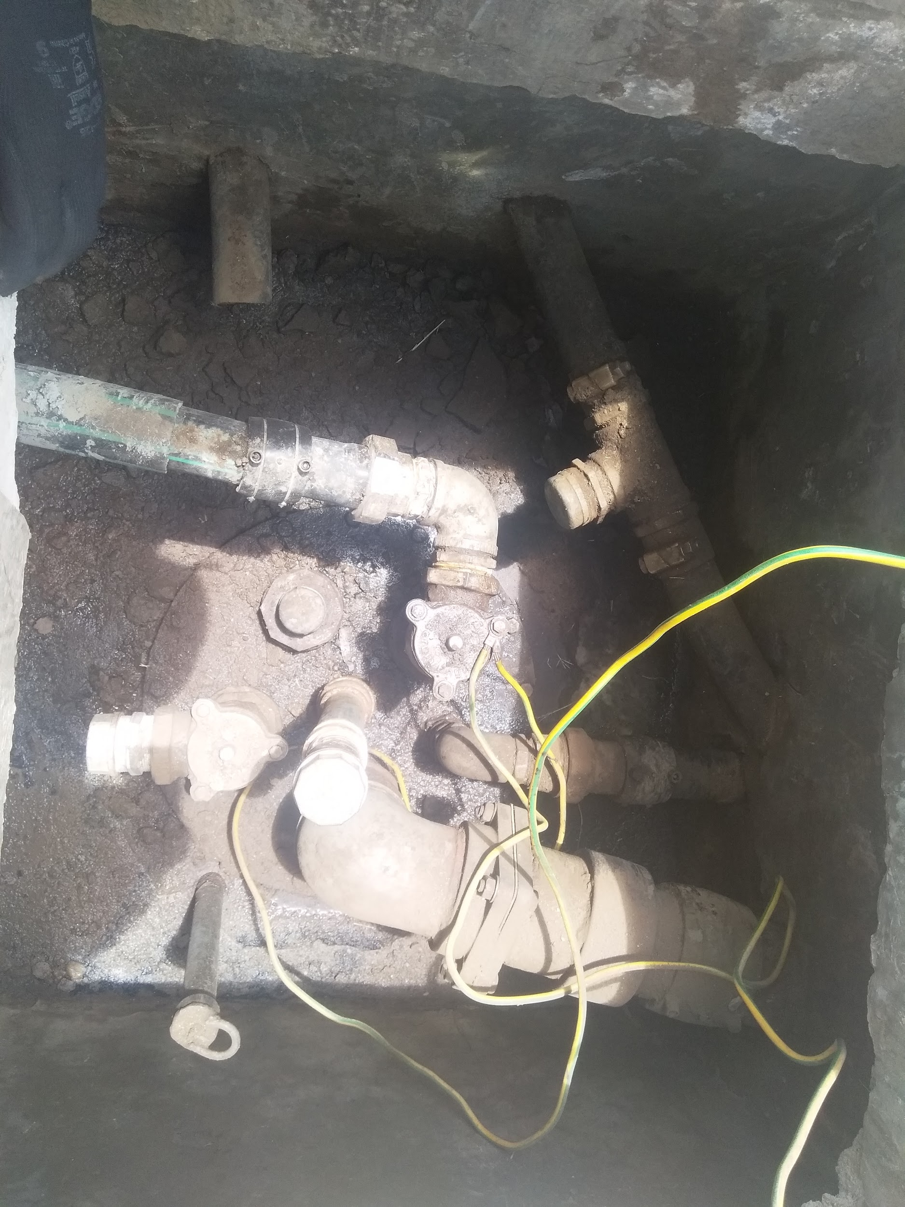
Challenges(Cont..)
2. No suitable pipe wrench to open the hexagon nut for UTS probe mounting on tank riser - .Require a 32‘’ Pipe wrench
Notes:
Sourcing of hexagonal sure torque / 32pipewrench WIP

Slide 7
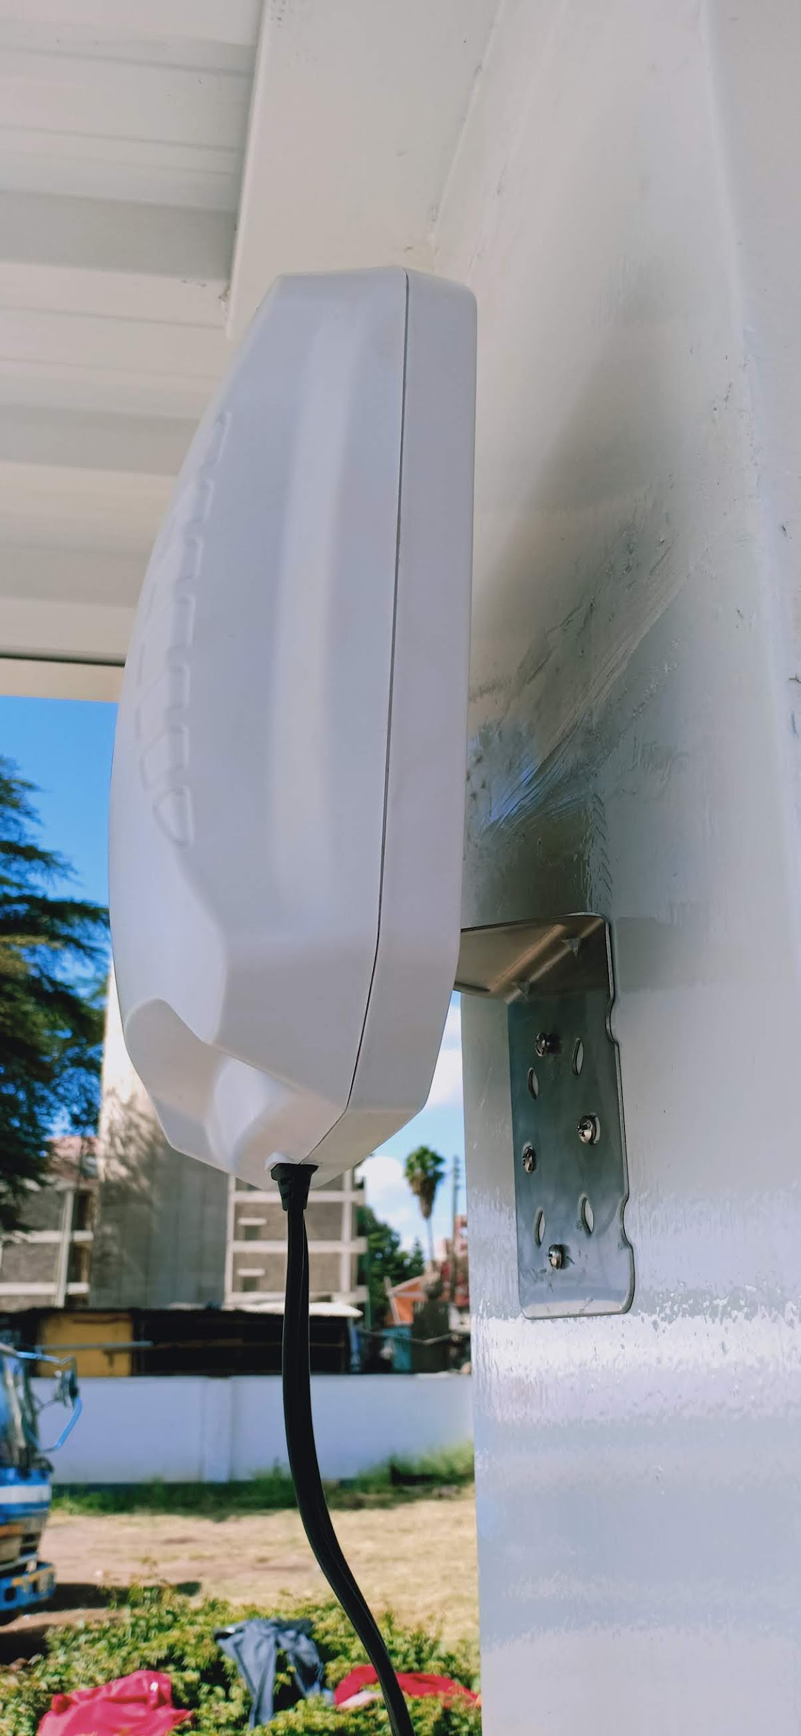
Challenges(Cont..)
3. Cable from antenna to modem was short due to the antenna mounting height (2.3M) - Requires extension (currently sourcing)

Slide 8
Areas to improve and future plans
Preparation of packing list template
Deployment of electrical panels sub-assembly, mains cables installation, tablet and modem sub assembly to be done prior to installation day
- This will help reduce time taken to <5 hrs from current 7.5 hrs

Slide 9
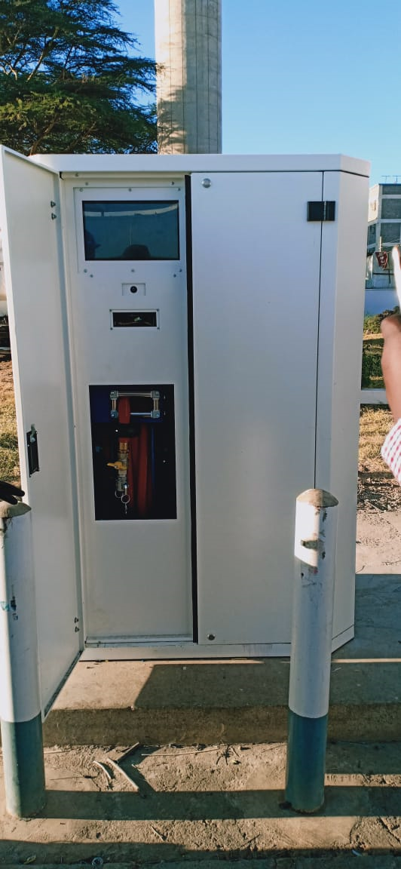
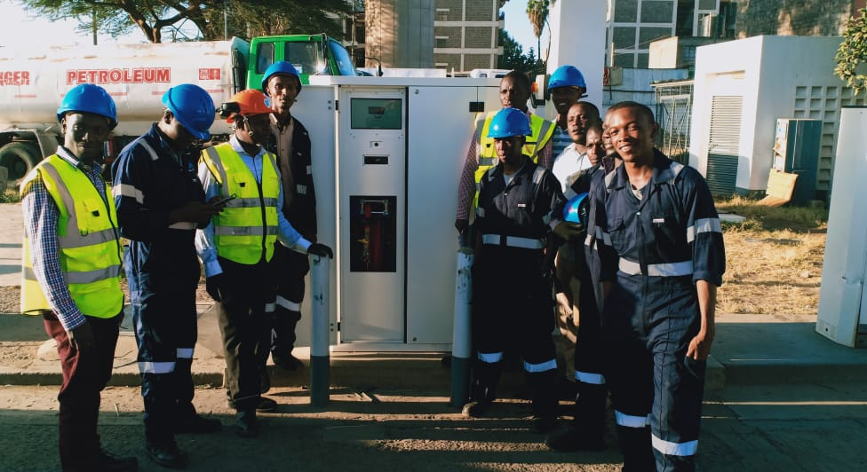
PICTURES

Slide 10
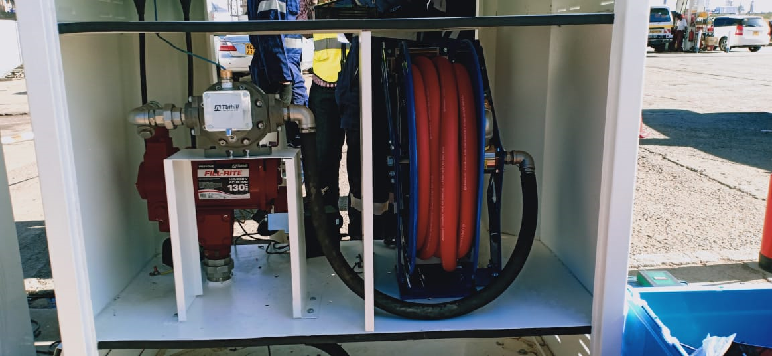
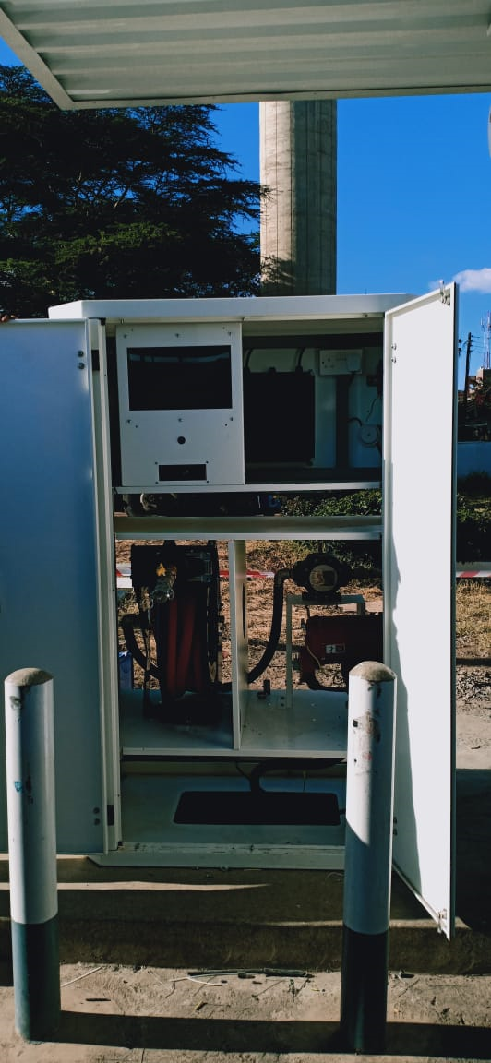
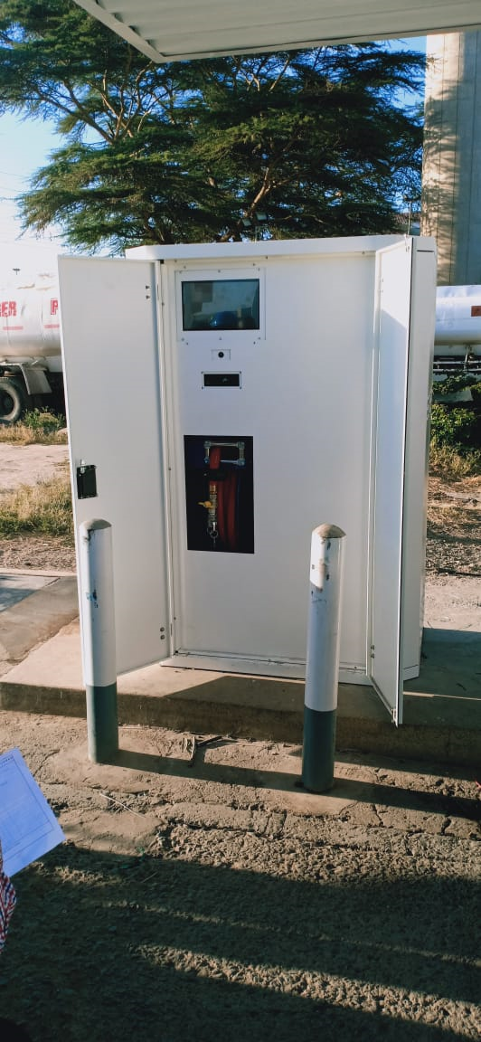
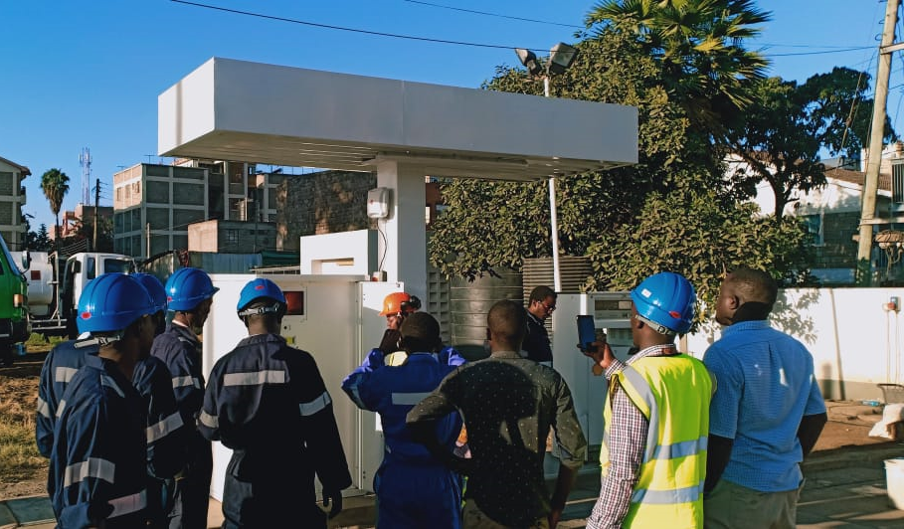
PICTURES cont...

